Slide 1


Kamalakar
12/12/2022

Slide 2

Outline
Executive Summary
Introduction
Methodology
Results
Conclusion
Appendix

Slide 3
Executive Summary
In this capstone project, we will predict if the SpaceX Falcon 9 first stage will land successfully using several machine learning classification algorithms.
The main steps in this project include:
Data collection, wrangling, and formatting
Exploratory data analysis
Interactive data visualization
Machine learning prediction
Our graphs show that some features of the rocket launches have a correlation with the outcome of the launches, i.e., success or failure.
It is also concluded that decision tree may be the best machine learning algorithm to predict if the Falcon 9 first stage will land successfully.

Slide 4
Introduction
In this capstone project, we will predict if the SpaceX Falcon 9 first stage will land successfully using several machine learning classification algorithms.
The main steps in this project include:
Data collection, wrangling, and formatting
Exploratory data analysis
Interactive data visualization
Machine learning prediction
Our graphs show that some features of the rocket launches have a correlation with the outcome of the launches, i.e., success or failure.
It is also concluded that decision tree may be the best machine learning algorithm to predict if the Falcon 9 first stage will land successfully.

Slide 5

Section 1

Slide 6
Executive Summary
Data collection methodology:
SpaceX APIWeb scraping
Perform data wrangling
Pandas and NumPy
SQL
Perform exploratory data analysis (EDA) using visualization and SQL
Perform interactive visual analytics using Folium and Plotly Dash
Perform predictive analysis using classification models
Machine learning prediction, using
Logistic regression
Support vector machine (SVM)
Decision tree
K-nearest neighbors (KNN)

Slide 7

Data Collection
Web scraping
The data is scraped from https://en.wikipedia.org/w/index.php?title=List_of_Falcon_9_and_Falcon_Heavy_launches&oldid=1027686922
The website contains only the data about Falcon 9 launches.
We end up with 121 rows or instances and 11 columns or features. The picture below shows the first few rows of the data:

Slide 8
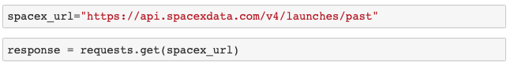
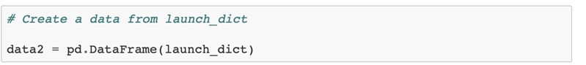
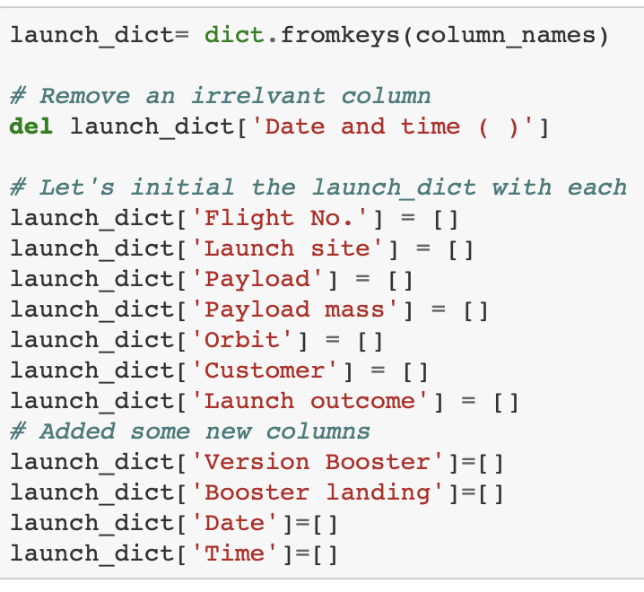
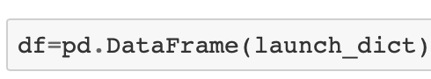
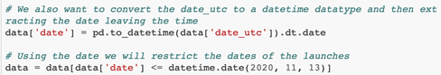
Data Collection – SpaceX API
Step-1
Make a GET response to the SpaceX REST API
Step-3
Create Pandas Dataframe
Step 4
Use column names as keys in dictionaries
Convert to Pandas
Step-2
Define lists for data to be stored in
Clean data
Use these lists as values in a dictionary and construct the dataset

Slide 9
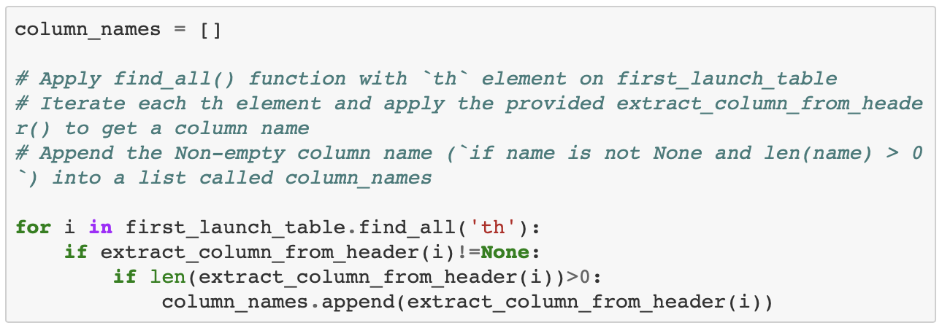
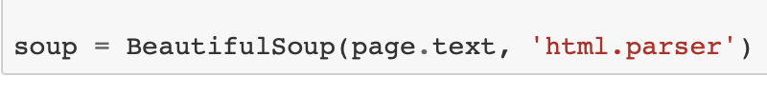
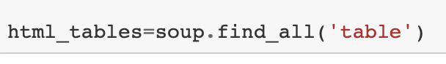
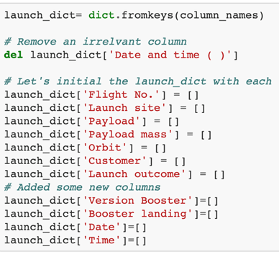
Data Collection - Scraping
Step-1
Request HTML page
Step-3
Extract Column Names from tables in HTML Page
Step-2
Create BeautifulSoup object
Step-4
Use column names as keys in dictionaries
Convert to Pandas
Fill all the table in the HTML Page

Slide 10
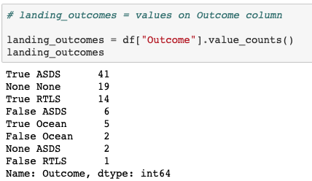
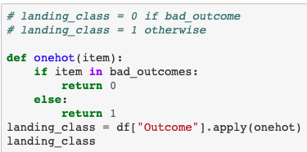
Data Wrangling
Displaying the Landing Outcome Columns
Creating a list [landing class]to check if the booster would land successfully or not.
Exporting the Data frame to a .csvfile

Slide 11
EDA with Data Visualization
SCATTER CHARTS
BAR CHART
LINE CHARTS
Flight Number vs Launch Site
Payload vs Launch Site
Orbit Type vs Flight Number
Payload vs Orbit Type
Success Rate vs Orbit Type
Success Rate vs Year

Slide 12
EDA with SQL
Loading the Dataset using the IBM DB2 Database
Query the Data using Python
Performed different queries (10) to understand the dataset better
Queries included [Displaying: names of unique launch sites, average payload mass carried by booster version etc……

Slide 13
Build an Interactive Map with Folium
The following steps were taken to visualize the launch data on an interactive map:
Mark all launch sites on a map
Initialise the map using a Folium Map object
Add a folium.Circle and folium.Marker for each launch site on the launch map
Mark the success/failed launches for each site on a map
As many launches have the same coordinates, it makes sense to cluster them together.
Before clustering them, assign a marker colour of successful (class = 1) as green, and failed (class = 0) as red.
To put the launches into clusters, for each launch, add a folium.Marker to the MarkerCluster() object.
Create an icon as a text label, assigning the icon_color as the marker_colour determined previously.
Calculate the distances between a launch site to its proximities
To explore the proximities of launch sites, calculations of distances between points can be made using the Lat and Long values.
After marking a point using the Lat and Long values, create a folium.Marker object to show the distance.
To display the distance line between two points, draw a folium.PolyLine and add this to the map.

Slide 14
Build a Dashboard with Plotly Dash
PLOTLY DASH
Creating an interactive dashboard with Pie charts and Scatter Plots/Graphs
Pie chart
Used to show distribution of successful launches across all launch sites
Shows success/failure ratio for each individual site
Scatter plot
Shows us how success varies across different launch sites, payload mass and booster version

Slide 15
Predictive Analysis (Classification)
Model Evaluation
Model Evaluation
Best Fit Classification
To prepare the dataset for model development:
Load dataset
Perform necessary data transformations (standardise and pre-process)
Split data into training and test data sets, using train_test_split()
Decide which type of machine learning algorithms are most appropriate
For each chosen algorithm:
Create a GridSearchCV object and a dictionary of parameters
Fit the object to the parameters
Use the training data set to train the model
For each chosen algorithm:
Using the output GridSearchCV object:
Check the tuned hyperparameters (best_params_)
Check the accuracy (score and best_score_)
Plot and examine the Confusion Matrix
Review Accuracy Score
Check which accuracy score is the highest to determine the best performing model

Slide 16
Results
Exploratory data analysis results
Interactive analytics
Predictive analysis results

Slide 17

Section 2

Slide 18
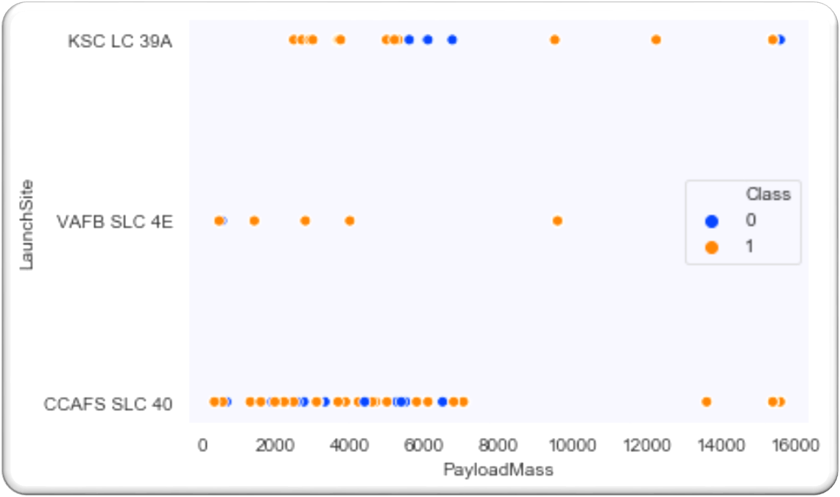
Payload vs. Launch Site
The scatter plot of Launch Site vs. Payload Mass shows that:
Above a payload mass of around 7000 kg, there are very few unsuccessful landings, but there is also far less data for these heavier launches.
There is no clear correlation between payload mass and success rate for a given launch site.
All sites launched a variety of payload masses, with most of the launches from CCAFS SLC 40 being comparatively lighter payloads (with some outliers).

Slide 19
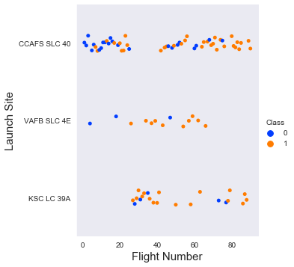
Flight Number vs. Launch Site
The scatter plot of Launch Site vs. Flight Number shows that:
As the number of flights increases, the rate of success at a launch site increases.
Most of the early flights (flight numbers < 30) were launched from CCAFS SLC 40, and were generally unsuccessful.
The flights from VAFB SLC 4E also show this trend, that earlier flights were less successful.
No early flights were launched from KSC LC 39A, so the launches from this site are more successful.
Above a flight number of around 30, there are significantly more successful landings (Class = 1).

Slide 20
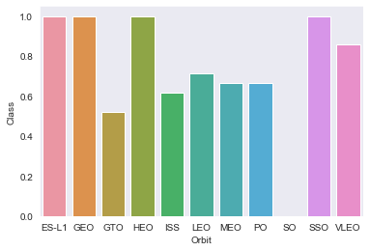
Success Rate vs. Orbit Type
Orbits with 100% success rate
ES-L1 (Earth-Sun First Lagrangian Point),
GEO (Geostationary Orbit),
HEO (High Earth Orbit),
SSO (Sun-synchronous Orbit)
Orbits with 0% success rate
SO (Heliocentric Orbit

Slide 21
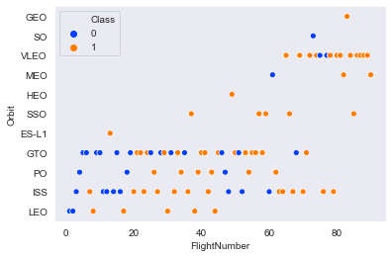
Flight Number vs. Orbit Type
The scatter plot of Orbit Type vs Flight Number shows that:
The 100% success rate of GEO, HEO, and ES-L1 orbits can be explained by only having 1 flight into the respective orbits.
Success rate in SSO is more impressive, with 5 successful flights.
Relationship between Flight Number and Success Rate for GTO is little.

Slide 22
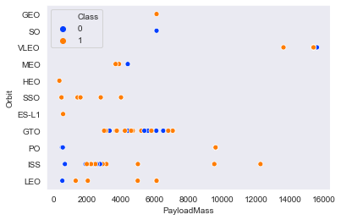
Payload vs. Orbit Type
The scatter plot of Orbit Type vs Payload Mass shows that:
Orbits types (PO, ISS and LEO) have more success with heavy payloads
Relationship between payload mass and success rate in GTO is unclear.
VLEO (Very Low Earth Orbit) launches are associated with heavier payloads.

Slide 23
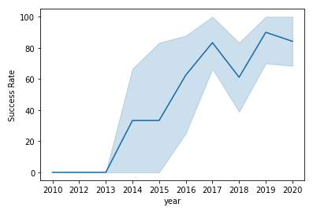
Launch Success Yearly Trend
The line chart of yearly average success rate shows that:
Between 2010 and 2013, all landings were unsuccessful (as the success rate is 0).
After 2013, the success rate generally increased, despite small dips in 2018 and 2020.
After 2016, there was always a greater than 50% chance of success.

Slide 24
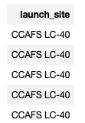
All Launch Site Names
Find the names of the unique launch sites
Present your query result with a short explanation here
The word Distinct returns only unique values from the LAUNCH_SITE column of the SPACEXTBL table
%sql SELECT DISTINCT LAUNCH_SITE as "Launch_Sites" FROM SPACEX

Slide 25
Launch Site Names Begin with 'CCA'
Find 5 records where launch sites begin with `CCA`
Present your query result with a short explanation here
**LIMIT 5 fetches only 5 records, and the LIKE keyword is used with the wild card ‘CCA%’ to retrieve string values beginning with ‘CCA’.
%sql SELECT * FROM SPACEX WHERE LAUNCH_SITE LIKE 'CCA%' LIMIT 5;

Slide 26
Total Payload Mass
Calculate the total payload carried by boosters from NASA
%sql SELECT SUM(PAYLOAD_MASS__KG_) AS "Total Payload Mass by NASA (CRS)" FROM SPACEX WHERE CUSTOMER = 'NASA (CRS)';
Present your query result with a short explanation here
**The SUM keyword is used to calculate the total of the LAUNCH column, and the SUM keyword (and the associated condition) filters the results to only boosters from NASA (CRS).
Total Payload Mass by NASA (CRS)
22007

Slide 27
Average Payload Mass by F9 v1.1
Calculate the average payload mass carried by booster version F9 v1.1
%sql SELECT AVG(PAYLOAD_MASS__KG_) AS "Average Payload Mass by Booster Version F9 v1.1" FROM SPACEX \WHERE BOOSTER_VERSION = 'F9 v1.1';
Present your query result with a short explanation here
**The AVG keyword is used to calculate the average of the PAYLOAD_MASS__KG_ column, and the WHERE keyword (and the associated condition) filters the results to only the F9 v1.1 booster version.
Average Payload Mass by Booster Version F9 v1.1
3676

Slide 28
First Successful Ground Landing Date
Find the dates of the first successful landing outcome on ground pad
%sql SELECT MIN(DATE) AS FIRST_SUCCESSFUL_GROUND_LANDING FROM SPACEX \WHERE LANDING__OUTCOME = 'Success (ground pad)';
Present your query result with a short explanation here
**The MIN keyword is used to calculate the minimum of the DATE column, i.e. the first date, and the WHERE keyword (and the associated condition) filters the results to only the successful ground pad landings.
first_successful_ground_landing
2017-01-05

Slide 29
Successful Drone Ship Landing with Payload between 4000 and 6000
List the names of boosters which have successfully landed on drone ship and had payload mass greater than 4000 but less than 6000
Present your query result with a short explanation here
%sql SELECT BOOSTER_VERSION FROM SPACEX WHERE LANDING__OUTCOME = 'Success (drone ship)' \ AND PAYLOAD_MASS__KG_ > 4000 AND PAYLOAD_MASS__KG_ < 6000;
booster_version
F9 FT B1022
F9 FT B1031.2
**The WHERE keyword is used to filter the results to include only those that satisfy both conditions in the brackets (as the AND keyword is also used). The BETWEEN keyword allows for 4000 < x < 6000 values to be selected.

Slide 30
Total Number of Successful and Failure Mission Outcomes
Calculate the total number of successful and failure mission outcomes
Present your query result with a short explanation here
**The COUNT keyword is used to calculate the total number of mission outcomes, and the GROUPBY keyword is also used to group these results by the type of mission outcome.
%sql SELECT MISSION_OUTCOME, COUNT(MISSION_OUTCOME) AS TOTAL_NUMBER FROM SPACEX GROUP BY MISSION_OUTCOME;
mission_outcome | total_number
Success | 44
Success (payload status unclear) | 1

Slide 31
Boosters Carried Maximum Payload
List the names of the booster which have carried the maximum payload mass
Present your query result with a short explanation here
**The SELECT statement within the brackets finds the maximum payload, and this value is used in the WHERE condition. The DISTINCT keyword is then used to retrieve only distinct /unique booster versions
%sql SELECT DISTINCT(BOOSTER_VERSION) FROM SPACEX \ WHERE PAYLOAD_MASS__KG_ = (SELECT MAX(PAYLOAD_MASS__KG_) FROM SPACEX);
booster_version
F9 B5 B1048.4
F9 B5 B1049.4
F9 B5 B1049.5
F9 B5 B1058.3
F9 B5 B1060.2

Slide 32
2015 Launch Records
List the failed landing_outcomes in drone ship, their booster versions, and launch site names for in year 2015
Present your query result with a short explanation here
**The WHERE keyword is used to filter the results for only failed landing outcomes, AND only for the year of 2015.
%sql SELECT BOOSTER_VERSION, LAUNCH_SITE FROM SPACEX \ WHERE (LANDING__OUTCOME = 'Failure (drone ship)') AND (EXTRACT(YEAR FROM DATE) = '2015');
booster_version | launch_site
F9 v1.1 B1012 | CCAFS LC-40

Slide 33
Rank Landing Outcomes Between 2010-06-04 and 2017-03-20
Landing Outcome | Total Count
No attempt | 7
Failure (drone ship) | 2
Success (drone ship) | 2
Success (ground pad) | 2
Controlled (ocean) | 1
Failure (parachute) | 1
Rank the count of landing outcomes (such as Failure (drone ship) or Success (ground pad)) between the date 2010-06-04 and 2017-03-20, in descending order
%sql SELECT LANDING__OUTCOME as "Landing Outcome", COUNT(LANDING__OUTCOME) AS "Total Count" FROM SPACEX \ WHERE DATE BETWEEN '2010-06-04' AND '2017-03-20' \ GROUP BY LANDING__OUTCOME \ ORDER BY COUNT(LANDING__OUTCOME) DESC ;
Present your query result with a short explanation here
**The WHERE keyword is used with the BETWEEN keyword to filter the results to dates only within those specified. The results are then grouped and ordered, using the keywords GROUP BY and ORDER BY, respectively, where DESC is used to specify the descending order.

Slide 34

Section 3

Slide 35




ALL LAUNCH SITES ON A MAP
All SpaceX launch sites are on coasts of the United States of America, specifically Florida and California.

Slide 36





Success and Failed Launches For Each Site
Launches have been grouped into clusters, green icons for successful launches, and red icons for failed launches.
CCAFS SLC-40 and CCAFS LC-40
VAFB SLC-4E
KSC LC-39A

Slide 37
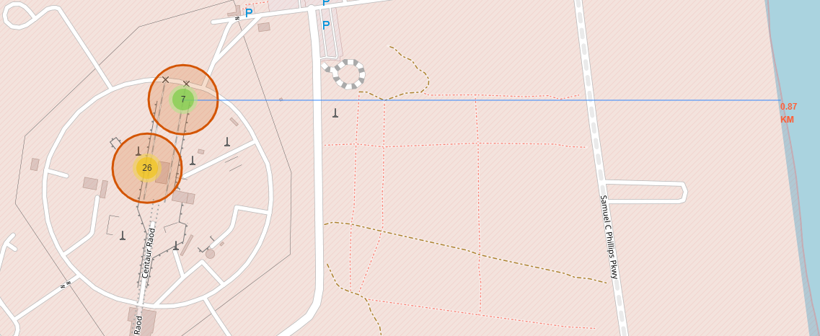
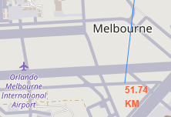
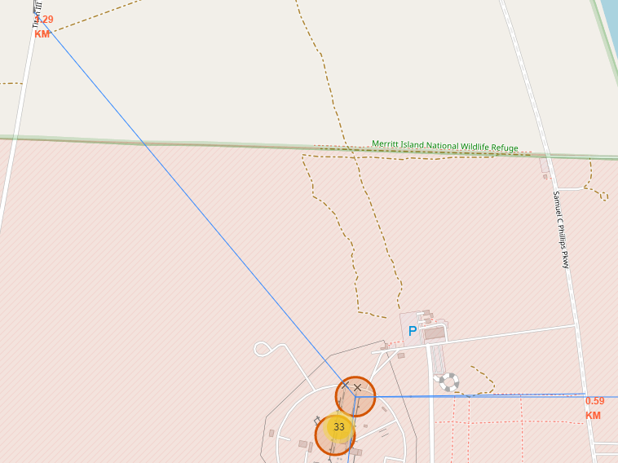
Location Proximities of Launch Sites to important locations
Launch sites in close proximity to railways? YES.
Launch sites in close proximity to highways? YES.
Nearest highway = 0.59km away.
Launch sites in close proximity to railways? YES.
Nearest railway = 1.29 km away.

Slide 38

Section 4

Slide 39

Launch Success Count for All Sites
The launch site KSC LC-39 A had the most successful launches, with 41.7% of the total successful launches.

Slide 40

launch site with highest launch success ratio
The launch site KSC LC-39 A also had the highest rate of successful launches, with a 76.9% success rate.

Slide 41

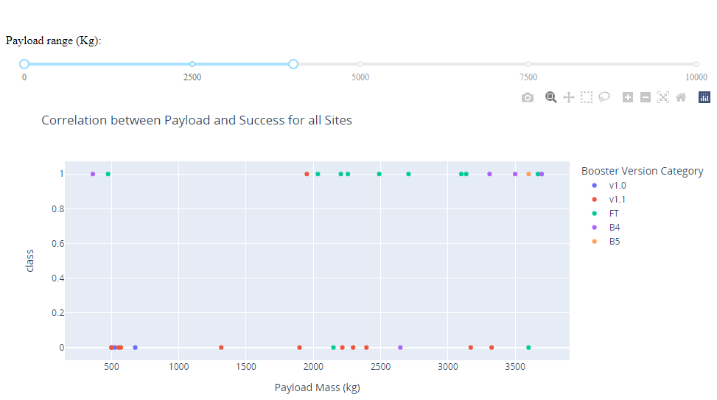
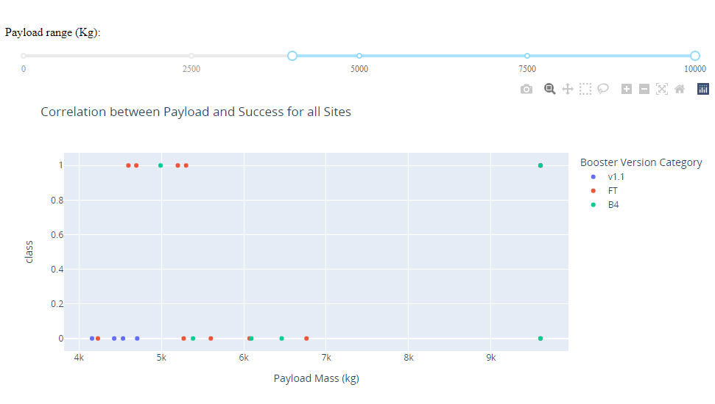

Launch Outcome VS. Payload scatter plot for all sites
Plotting the launch outcome vs. payload for all sites shows a gap around 4000 kg, so it makes sense to split the data into 2 ranges:
0 – 4000 kg (low payloads)
4000 – 10000 kg (massive payloads)
From these 2 plots, it can be shown that the success for massive payloads is lower than that for low payloads.
It is also worth noting that some booster types (v1.0 and B5) have not been launched with massive payloads.
Note: c$lass\left\{\begin{aligned}0, Failure \\ 1, Success\end{aligned}\right.$

Slide 42

Section 5

Slide 43
Classification Accuracy
 | Algorithm | Accuracy Score | Best Score
0 | KNN | 0.833333 | 0.846429
1 | Decision Tree | 0.833333 | 0.848214
2 | Logistic Regression | 0.888889 | 0.885714
3 | SVM | 0.833333 | 0.848214
Plotting the Accuracy Score and Best Score for each classification algorithm produces the following result:
The Decision Tree model has the highest classification accuracy
The Accuracy Score is 88.88%
The Best Score is 88.88%

Slide 44
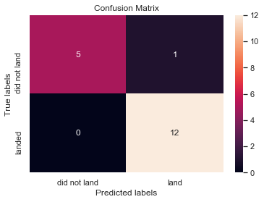
Confusion Matrix
As shown previously, best performing classification model is the Decision Tree model, with an accuracy of 94.44%.
This is explained by the confusion matrix, which shows only 1 out of 18 total results classified incorrectly (a false positive, shown in the top-right corner).
The other 17 results are correctly classified (5 did not land, 12 did land).

Slide 45
Conclusions
As the number of flights increased, the rate of success at a launch site increased.
Most of the early flights were unsuccessful.
Between 2010 and 2013, all landings were unsuccessful
After 2013, the success rate generally increased, despite small dips in 2018 and 2020.
Orbit types ES-L1, GEO, HEO, and SSO, have the highest success rate of 100%.
Launch site KSC LC-39 A had the most successful launches, with 41.7% of the total successful launches, and also the highest rate of successful launches, with a 76.9% success rate.

Slide 46
Appendix
https://github.com/kkamalk/ibm_final.git

Slide 47


